Slide 1
Reduce Member Anxiety, Build Loyalty:
Creating Emotional Engagement in Digital Channels
Discovery Conference
August 15, 2019

Slide 2
Credit Unions Beat Competitors on Key CX Metrics…
N= 1,005.
CX Success. Thinking of your most recent interactions with your primary financial institution, to what degree were you able to accomplish what you wanted to do? [Select one]
CX Effort. Thinking of your most recent interactions with your primary financial institution, how easy was it to interact with them? [Select one]
CX Emotion. Thinking of your most recent interactions with your primary financial institution, how did you feel about those interactions? [Select one]
Source: CUNA Mutual proprietary consumer research conducted March 2019
Notes:
Recent CUNA Mutual proprietary research confirms what other research has shown for a number of years ➔ credit unions beat other financial institutions in terms Primary Financial Institution CX Ratings. We measured customer experience using the Temkin Experience Ratings which are an open standard for measuring customer experience. It’s based on three questions that measure key elements of every customer experience:
CX Success – degree to which customer able to accomplish what they wanted to
CX Effort – how easy it was to interact with their PFI
CX Emotion – how the interactions made the customer feel
As the graph shows, credit unions beat all other Fis on all three questions. [Note: every rating was
Note: CX Ratings are not exactly the same as satisfaction ratings. ACSI last fall announced banks and Cus are now tied in terms of customer satisfaction. Without seeing detailed satisfaction results from ACSI, I cannot explain why Cus don’t beat banks, but I suspect it has something to do with perceptions of branch coverage, digital capabilities and breadth of product suite, rather than actual experience.

Slide 3

…By Delivering a Highly Consultative Member Experience
Member Perspective:
“I have been using XYZ Credit Union for the past few years and the service has been amazing. They are always very helpful to sit down and talk about my accounts and questions. Additionally they also have very low fees and always put the customers’ interest first.”
CU Exec Perspective:
“When having that first conversation with a member, we feel it is important to talk not only about the approval process but what they should expect [in terms of] next steps... [We also] discuss the pros and cons of the loan going forward on their financial stability…”
Source: CUNA Mutual proprietary research of CU executives conducted May 2019; depositaccounts.com
Notes:
We believe that CUs beat banks in terms of CX ratings because of the consultative members experience that credit unions deliver.
Here are a couple quotes that suggest CUs offer a highly consultative member experience. [READ QUOTES]
Member quote is an actual member online rating of their credit union. CU Exec quote comes from a recent CUNA Mutual research study of credit unions.
As you can see, members generally received a highly personalized, consultative experience when meeting with credit union loan officers.
As more and more borrowers migrate to digital channels…

Slide 4
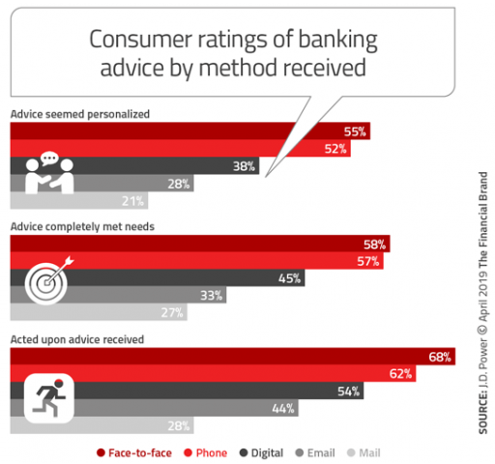
Providing a Consultative Digital Experience is a Challenge
Source: JD Power, “Bank Customers Happier Using Branch+Digital Than Digital Only”, thefinancialbrand.com, 5/13/2019
Notes:
[READ TITLE]
According to JD Power, consumer ratings of the banking advice they receive digitally trails the advice they receive via face-to-face and phone channels in terms of personalization and completely meeting their needs.
Accordingly, fewer consumers report having acted upon the advice they received via digital channels vs. face-to-face and phone channels.
These results suggest that it can be very challenging to deliver the traditional credit union consultative experience digitally.
Speaking points added: - Consumer’s use of digital channels continues to grow and as a result 90% of all FI’s are increasing their Digital Spend (65% increasing more than 10%)

Slide 5
Providing a consultative experience digitally is hard.
Notes:
To sum up, [READ SLIDE].

Slide 6
Providing a consultative experience digitally is hard.
But consumers want digital experiences.
Notes:
[READ SLIDE].

Slide 7
Providing a consultative experience digitally is hard.
But consumers want digital experiences.
Financial institutions are investing to deliver.
Notes:
[READ SLIDE].
NOTE: Changed “working hard” to “investing”

Slide 8
What happens when everyone is delivering an easy & fast digital experience?
Notes:
[READ SLIDE].

Slide 9

Research From Bain Provides a Hint
Top Five Customer Experience Elements Linked to Net Promoter Score in Banking
Quality – Does the FI have first-class products/services needed for financial success?
Source: “In Search Of Customers Who Love Their Bank”, Bain & Co., 11/18/2018
Notes:
A recent study by Bain & Co. provides a hint at the future battle ground for differentiation in financial services.
The Bain study highlighted five customer experience elements for banking with the strongest link to customer loyalty, as measured by the Net Promoter Score.
The first one, quality, could almost be considered table stakes for the majority of consumers. [Read Chevron]
https://thefinancialbrand.com/80293/trust-loyalty-digital-banking-big-tech-amazon-paypal

Slide 10

Research From Bain Provides a Hint
Top Five Customer Experience Elements Linked to Net Promoter Score in Banking
Quality – Does the FI have first-class products/services needed for financial success?
Simplifies – Does the FI make it easy to bank with them?
Source: “In Search Of Customers Who Love Their Bank”, Bain & Co., 11/18/2018
Notes:
The second element, Simplifies, is a current battleground for differentiation in financial services. [Read Chevron]
Digital transformation is one the key enablers of a simple experience.
Rocket Mortgage’s mortgage application process is a great example of a company trying to differentiate itself by providing an experience that simplifies consumers’ lives.

Slide 11

Research From Bain Provides a Hint
Top Five Customer Experience Elements Linked to Net Promoter Score in Banking
Quality – Does the FI have first-class products/services needed for financial success?
Simplifies – Does the FI make it easy to bank with them?
Saves Time – Can a person conduct their financial business quickly with this FI?
Source: “In Search Of Customers Who Love Their Bank”, Bain & Co., 11/18/2018
Notes:
The third element, Saves Time, is also currently a battleground for differentiation in financial services. [Read Chevron]
Again, digital transformation is one the key enablers of an experience that saves time.
A good example of an experience that saves time are those lenders, including some credit unions, that are able to offer an “instant decision” on applications for certain types of loans.

Slide 12

Research From Bain Provides a Hint
Top Five Customer Experience Elements Linked to Net Promoter Score in Banking
Quality – Does the FI have first-class products/services needed for financial success?
Simplifies – Does the FI make it easy to bank with them?
Saves Time – Can a person conduct their financial business quickly with this FI?
Heirloom – Does the FI represent a good investment for future generations?
Source: “In Search Of Customers Who Love Their Bank”, Bain & Co., 11/18/2018
Notes:
The fourth element, Heirloom, is somewhat difficult to describe. [Read Chevron]
Some have argued that providing an experience that delivers on the heirloom experience is vital for financial services given the link between money and inheritance.
Longevity or staying power obviously plays a role with regard to this element. Startups that don’t have a track record have an uphill struggle to demonstrate that the deliver an heirloom-like experience.

Slide 13

Research From Bain Provides a Hint
Top Five Customer Experience Elements Linked to Net Promoter Score in Banking
Quality – Does the FI have first-class products/services needed for financial success?
Simplifies – Does the FI make it easy to bank with them?
Saves Time – Can a person conduct their financial business quickly with this FI?
Heirloom – Does the FI represent a good investment for future generations?
Reduces Anxiety – Does the FI make me feel confident in managing my finances?
Source: “In Search Of Customers Who Love Their Bank”, Bain & Co., 11/18/2018
Notes:
Our fifth element, Reduces Anxiety, is the only one addresses the emotional aspect of customer experience. [READ]
Bain argues that financial institutions have an opportunity to further increase loyalty by reducing customers’ anxiety.
For this reason, we believe that the future battleground for differentiation in financial services will be focused on this element of customer experience. As we’ll see later in this presentation, we already see some progressive financial services firms taking steps to address their customers’ stress and worries.

Slide 14
Potential Value Curve for Financial Services in the Digital Age
High
Level of Delivery
Low
Notes:
Finally, we rated credit unions’ potential level of delivery on the 5 elements of customer experience. Remember, this is not where credit unions are today, rather this is where they could be in the future.
We rated delivery on quality high for credit unions. Like banks, credit unions definitely offer financial products / services that help members successfully manage their financial lives.
Given the difference in the scale of their digital investment, we rated credit unions lower than the national banks on delivery of “simplifies” and “saves time”. It would require massive investment by credit unions to leapfrog both the national banks and the fintech startups.
Like the national banks, we rated credit unions very high on heirloom – credit unions have also been around for a long time and, despite the long-term trend of consolidation, will likely be around for many years to come.
Finally, we believe credit unions have a huge opportunity to differentiate themselves from the fintech startups and national banks by owning “reduces anxiety”. In order for this potential point of differentiation to become a reality, credit unions must succeed in copying the consultative experience they currently offer through in-person and phone channels into the digital experiences they will deliver in the future.
NOTE: American Banker: Digital Banking 2019 (June 2019) – look at emotions as delighted (as easy and fast as possible) – not considering they consumer/member may be entering this process with anxiety

Slide 15
Agenda
01 | Americans Are Worried & Stressed Out
02 | Addressing Borrowers’ Worries/Stress Boosts Loyalty
03 | Actions that Can Reduce Worries/Stress Digitally
04 | Wrap up
2
Notes:
In our first section, we’ll take a look at some research which demonstrates that today’s consumers are worried & stressed out. And, “yes”, personal finances are one of the key things that causes these worries and stress.
We will then take a look at some proprietary research CUNA Mutual recently conducted that examined borrowers’ stress and worries during the lending event.
We’ll then take a look at some real-world examples of lenders taking action to alleviate borrowers’ stress and worries.
And finally, we’ll wrap up with some key take-aways and concluding questions.
Let’s now take a look at some of the research findings show how worried & stressed American consumers are.

Slide 16
Americans Are Worried & Stressed Out

Slide 17
Americans’ Stress and Worries Reach Historical Highs
Source: “Americans' Stress, Worry and Anger Intensified in 2018”, Gallup News, 4/25/2019
Notes:
Stress, worry and anger are on the rise in America. With a 55 percent stress rate, the U.S. now ranks even with such nations as Albania, Iran and Sri Lanka. The highest stress levels were reported among Americans aged 30 to 49, where 65 percent reported experiencing stress the prior day. The figure was just one percent lower for Americans aged 15 to 29, where 64 percent reported experiencing stress the prior day.
The new Gallup poll also measured worry and anger. Nearly half of Americans (45 percent) indicated that they felt worried a lot while 22 percent said they felt anger a lot. All three measurements (stress, worry and anger) had increased measurably since the prior poll.

Slide 18

Specific Financial Anxieties of U.S. Consumers
39%
I am more anxious when spending money today than I was five years ago
29%
I feel anxious about my current financial situation
20%
I don’t like to think about money
20%
My level of debt is ruining the quality of my life
N= 1,005
M10. Please indicate the degree to which you agree or disagree with each of the following statements regarding money and finances.
Source: CUNA Mutual proprietary consumer research conducted March 2019
Notes:
Personal finances appear to be a key driver behind the uptick in consumers’ stress and worries.
For the past four years, CUNA Mutual has asked American consumers whether or not they worry about their family’s financial stability on a daily basis.
As you may recall, in our first year’s research in 2015 this number was alarming, with 62% of Americans saying that they worried about their family’s financial stability on a daily basis. We saw that trend down in both 2016 and 2017 hitting a low of 44% last year. However when we asked that same question of all consumers this past year it was back up to 58%.
Financial stress and worries are starting to negatively impact many American consumers’ emotional well-being. Earlier this year, CUNA Mutual commissioned a consumer research study to better understand the role that emotions play in the shaping consumers’ customer experience and customer loyalty perceptions. In total, 1,005 consumers completed the online survey. We found that significant portion of the U.S. consumer population say they have some sort of financial anxiety. [READ}
Interesting (and statistically significant) demographic differences:
I am more anxious when spending money today than I was five years ago
Not surprisingly, younger (21-34) consumers were significantly more likely to agree with this statement.
Females – 42%
Males – 35%
Household income >= $100K – 31%
Household income < $100K – 41%
I feel anxious about my current financial situation
Respondents who reported having children were significantly more likely to agree with this statement (33% vs. 27%).
Household income < $50K – 32%
Household income >= $100K – 24%
Note: Middle income category did not differ from other two groups by stat. significant margin – 27%)
Differences by age were also significant with 21-34, 35-44 and 55-64 significantly more likely to agree than 65+ (37% and 30% and 30% vs. 19%)
21-34 also were significantly more likely to agree than 45-54 (37% vs. 25%)
I don’t like to think about money
No significant differences for key demographics…
My level of debt is ruining the quality of my life
Again, big differences by age: 21-34 vs. 45-54, 55-64 and 65+ (28% vs. 16% and 18% and 13%)
35-44 vs. 65+ (22% vs. 13%)
African-Americans (not Hispanic) vs. White (not Hispanic) (29% vs. 18%)
Children Yes vs. Children No (24% vs. 18%)
College grad vs. College Incomplete (24% vs. 17%)

Slide 19
Higher Anxiety About Overall Finances = Lower CX Ratings
Anxious Customers/Members “Ding” Their PFIs By Giving Lower CX Ratings
N= 1,005.
CX Success. Thinking of your most recent interactions with your primary financial institution, to what degree were you able to accomplish what you wanted to do? [Select one]
CX Effort. Thinking of your most recent interactions with your primary financial institution, how easy was it to interact with them? [Select one]
CX Emotion. Thinking of your most recent interactions with your primary financial institution, how did you feel about those interactions? [Select one]
Source: CUNA Mutual proprietary consumer research conducted March 2019)
Notes:
Note: Full 1,005 consumer sample was asked these questions. Not able to flag demographic difference since questions were already cut by anxious / not anxious).
Furthermore, this research confirmed the significant role consumers’ emotions in shaping customer experience perceptions of consumers’ primary financial institution (PFI). Again we measured customer experience using Temkin Experience Ratings which is based on three questions that measure key elements of every customer experience:
CX Success – degree to which customer able to accomplish what they wanted to
CX Effort – how easy it was to interact with their PFI
CX Emotion – how the interactions made the customer feel
For all three questions, people who were not anxious, i.e., those who disagreed that they felt anxious about their current financial situation (defined as ratings of 1, 2, or 3 on a 10 pt. Strongly Disagree-Strongly Agree scale), rated their customer experience with their PFI significantly higher than those who were Anxious (4-10 ratings on a 10 pt. Strongly Disagree-Strongly Agree scale).
So emotions, specifically anxiety, really do have a tangible impact on customer experience perceptions.

Slide 20
Addressing Borrowers’ Worries/Stress Boosts Loyalty
Notes:
CUNA Mutual’s proprietary consumer research also examined the role of anxiety, worries and stress during the lending event shaped consumers’ customer experience and customer loyalty perceptions.

Slide 21
Leading Emotions Felt When Borrowing
Hopefulness was the most frequently cited emotion overall. However, many respondents felt either anxious, stressed, or afraid when deciding to apply or when applying for their loan.
N=476
M20. Which emotions did you feel when you were DECIDING TO APPLY for this loan?
M28: Which emotions did you feel DURING THE LOAN APPLICATION PROCESS?
Source: CUNA Mutual proprietary consumer research conducted March 2019
Notes:
Note: Full sample not used - 476 respondents indicated that they had applied for a loan within the past five years.
We asked consumers who applied for a loan in the past 5 years what emotions they the felt when deciding to apply for a loan and when they were completing the loan application. Respondents were free to check as many emotions as they wanted, i.e., it as possible for a respondent to mark both Happy and Stressed . Hopefulness was the most frequently cited emotion overall. However, you can see here that many respondents felt either anxious, stressed, or afraid when deciding to apply or when applying for their loan.
For purposes of this presentation, borrowers who were anxious, stressed and/or afraid at some point before or during the loan application will be referred to as: Worried / Stressed
Interesting (and statistically significant) demographic differences:
Anxious
Deciding to apply:
Females vs. males (44% vs. 33%)
Age 21-34 vs. 55-64 (46% vs. 28%)
During loan application:
Age 21-34 and 35-44 vs. 55-54 (44% and 42% vs. 25%)
Age 21-34 vs. 65+ (44% vs. 30%)
Income $50K-$100K vs. < $50K and >=$100K (47% vs. 34% and 25%)
Stressed
Deciding to apply:
Females vs. males (33% vs. 21%)
Age 21-34 and 35-44 vs. 55-54 and 65+ (34% and 35% vs. 21% and 16%)
During loan application:
Females vs. males (25% vs. 17%)
Afraid
Deciding to apply:
Age 21-34 vs. 35-44 and 45-54 (16% vs. 7% and 4%)
During loan application:
Age 21-34 and 35-44 and 45-54 (12% and 9% vs. 1%)
Age 21-34 vs. 55-64 (12% vs. 2%)
Note: 45-54 year olds were most hopeful at 58%.

Slide 22
Most Consumers Are Worried/Stressed Out When Borrowing
N=455.
M20. Which emotions did you feel when you were DECIDING TO APPLY for this loan?
M28: Which emotions did you feel DURING THE LOAN APPLICATION PROCESS?
Source: CUNA Mutual proprietary consumer research conducted March 2019
Note: Does not sum to 100% due to rounding.
Notes:
Note: Number of respondents who applied for a loan within the past 5 years and answered the emotion questions dropped from 476 to 455. Since pooled, can’t run stats testing, but look at notes for slide 27 to see what demographics “popped” for component questions.
We pooled the questions asking borrowers what emotions they experienced during both borrowing phases we examined, when deciding to apply for a loan and during the loan application process, to determine what percentage of borrowers did not report being Worried or Stressed.
We see in this chart that 4 out of 10 borrowers were not Worried or Stressed in either phase.
Three out of 10 borrowers reported being Worried or Stressed in both phases.
The remaining 31% of borrowers were Worried or Stressed in only one of the two phases we examined.

Slide 23
Most Borrowers Don’t Experience Any Lender Actions to Reduce Worry/Stress
N= 279.
M24: Did your lender take any actions to reduce your level of stress or anxiety WHEN YOU WERE DECIDING TO APPLY FOR THIS LOAN?
M32: Did your lender do anything to reduce your level of anxiety DURING THE LOAN APPLICATION PROCESS?
Note: Does not sum to 100% due to rounding
Notes:
Note: Sample size dropped to 279 since we are now looking at respondents who applied for a loan with the past 5 years and who reported that they were worried / stressed during one or both of the borrowing phases we examined. Small sample size limits ability to look at demographic differences.
For both borrowing phases, we asked respondents if their lender took any action to reduce their worries and stress. As you can see in this graph, the majority of respondents we asked (56%) reported that their lender took no such actions. Of those respondents who did indicate their lender took some sort of action, the largest percentage (195) reported that this action took place when the borrower was deciding to apply for the loan.
You are probably wondering what sorts of actions these lenders took. We did ask this question, but since it was an online survey and the open-ended responses unfortunately did not provide a lot of insight, e.g., “they reassured me”.

Slide 24
Acting to Reduce Worries/Stress = Higher CX Ratings
N= 279.
M24: Did your lender take any actions to reduce your level of stress or anxiety WHEN YOU WERE DECIDING TO APPLY FOR THIS LOAN?
M32: Did your lender do anything to reduce your level of anxiety DURING THE LOAN APPLICATION PROCESS?
CX Success. Thinking of your most recent interactions with your primary financial institution, to what degree were you able to accomplish what you wanted to do? [Select one]
CX Effort. Thinking of your most recent interactions with your primary financial institution, how easy was it to interact with them? [Select one]
CX Emotion. Thinking of your most recent interactions with your primary financial institution, how did you feel about those interactions? [Select one]
Source: CUNA Mutual proprietary consumer research conducted March 2019
Notes:
Note: Sample size dropped to 279 since we are now looking at respondents who applied for a loan within the past 5 years and who reported that they were worried / stressed during one or both of the borrowing phases we examined.
The importance of lenders taking action to reduce borrowers’ stress is driven home in this slide and the next one. Here we see that those borrowers whose lenders did take action to reduce their worries / stress gave significantly higher ratings on the three Temkin Experience Rating questions than borrowers who reported that their lenders took no such action.
Put another way, lenders that act to mitigate borrowers' worries/stress are rewarded with higher CX ratings. There is a pay-off for lenders that focus on the emotional element of CX by working to reduce borrrowers’ anxiety.

Slide 25
Acting to Reduce Worries/Stress = Higher Loyalty Ratings
Lenders that Act to Mitigate Borrowers' Worries are also Rewarded with Significantly Higher Loyalty Ratings
N=203.
M24: Did your lender take any actions to reduce your level of stress or anxiety WHEN YOU WERE DECIDING TO APPLY FOR THIS LOAN?
M32: Did your lender do anything to reduce your level of anxiety DURING THE LOAN APPLICATION PROCESS?
M36. How likely would you be to consider this financial institution for your next product or service?
M37. How likely would you be to recommend this institution to a friend or family member?
Source: CUNA Mutual proprietary consumer research conducted March 2019
Notes:
Note: Sample size dropped to 203 since we are now looking at respondents who applied for a loan with the past 5 years and who reported that they were worried / stressed during the second phase (during the loan application process), i.e., those people who reported being worried / stressed only when thinking about applying were not asked this question.
Here we see the linkage between lenders taking action to reduce borrowers’ worries / stress and two customer loyalty metrics: likelihood to consider the lender for the next purchase and likelihood to recommend the lender to a friend or family member. The differences between loyalty ratings of borrowers whose lenders took such action vs. borrowers whose lenders did not are HUGE (and statistically significant). There can be no doubt that lenders need to take steps to reduce borrowers worries / stress and they will be rewarded for doing so.
What are some of these actions that lenders should take? Looking at the sources of borrowers’ worry / stress provides some important clues.

Slide 26
What is Causing Anxiety When Deciding to Apply for a Loan?
 | Most Important Reason
 | 16%
 | 15%
 | 16%
 | 15%
 | 6%
Sources of Anxiety When Deciding to Apply for a Loan
N=230
M21. What caused the stress or anxiety you felt when you were DECIDING TO APPLY for this loan? M22. What is the single most important reason you were stressed or anxious?
Source: CUNA Mutual proprietary consumer research conducted March 2019
Notes:
When deciding to apply for a loan, respondents were most concerned with their own financial situation – namely if they had the right credit score, and if it was ultimately the right decision for a specific situation. [READ FIRST FEW SOURCES OF ANXIETY LISTED]
Graph percentage do not add to 100% since multiple sources of anxiety could be cited.
Most important reason – respondents could only pick one source of anxiety for this follow up question.

Slide 27
What is Causing Borrowers’ Anxiety While Applying for a Loan?
Sources of Anxiety During the Loan Application Process
 | Most Important Reason
 | 29%
 | 10%
 | 9%
 | 10%
 | 9%
N=215
M29. What caused the stress or anxiety you felt DURING THE LOAN APPLICATION process? M30. What is the single most important reason you were stressed or anxious?
Source: CUNA Mutual proprietary consumer research conducted March 2019
Notes:
Once the loan application process has started, respondents were most worried about being approved, and this was also the single most important source of anxiety. Respondents were also worried about their next steps in the event the loan was not approved.
[READ FIRST FEW SOURCES OF ANXIETY LISTED]
The sources of anxiety we just reviewed on this and the prior slide provide hints at the types of actions borrowers want their lenders to take to reduce their worries / stress. For example, what actions are lenders taking to reassure borrowers who are worried about not knowing if they would be approved?

Slide 28
Actions that Can Reduce Worries/Stress Digitally
Notes:
Using the sources of borrowers’ worries / stress as a guide, let’s now take a look at some real-world examples of lenders taking action to reduce borrowers’ anxiety.

Slide 29
Recommendations from Credit Union Executives
Before applying for a loan:
Offer financial literacy education programs and financial planning & budgeting assistance
When applying for a loan:
Ensure understanding of whole financial picture
Provide overview of the lending process / journey
Specify upfront what information will be needed
Make personalized recommendations
Communicate clearly and consistently throughout the process
When loan is denied:
Be transparent about reasons for denial
Offer advice on improving financial situation
Reassure member that a “no” now is not a “no” forever
Source: CUNA Mutual proprietary credit union research conducted April-May 2019
Notes:
Note: This one is text dense – I tried collapsing the key points in the B2B study into a single slide. Pls. let me know if it’s too much.
We shared some of these consumer research results with our online panel of credit union executives.
Here are some of their recommendations for addressing members’ worries and stress throughout the lending process
Depending on time, you might just hit on one or two bullets per lending stage

Slide 30
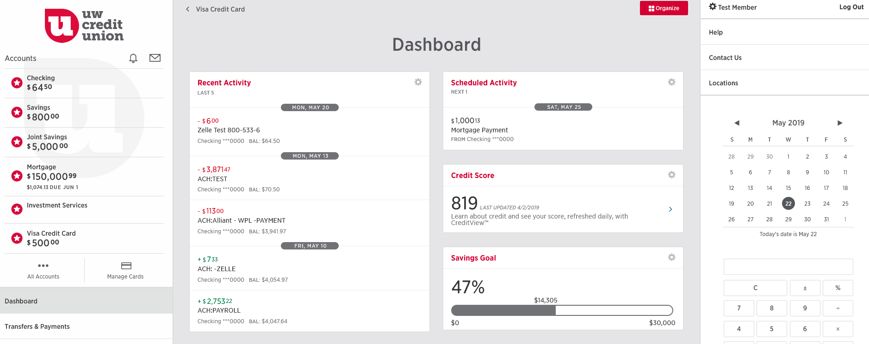
Borrowers’ Worries & Stress:
“Worried My Credit Score May Not Be High Enough”
Some financial institutions now offer credit scores to their customers
Credit score featured on web branch dashboard
Courtesy of UW Credit Union
Notes:
As the research I just shared demonstrates, many of the specific concerns of prospective borrowers involved their credit score. For example, some worried their score may not be high enough as they are deciding to apply for a loan. As we see here, providing credit scores as a free service to members is one way to address this stress or worry. In this example, the credit union makes the members’ credit score very accessible – it’s displayed on the main dashboard of their online banking platform. Some lenders also provide advice and tips on how a person can raise their credit scores.

Slide 31
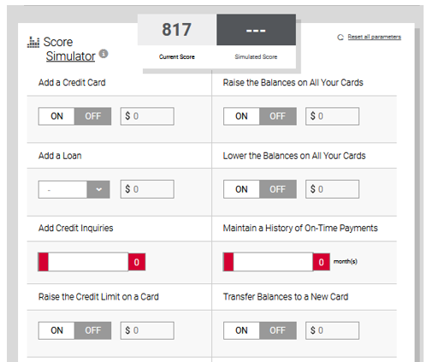
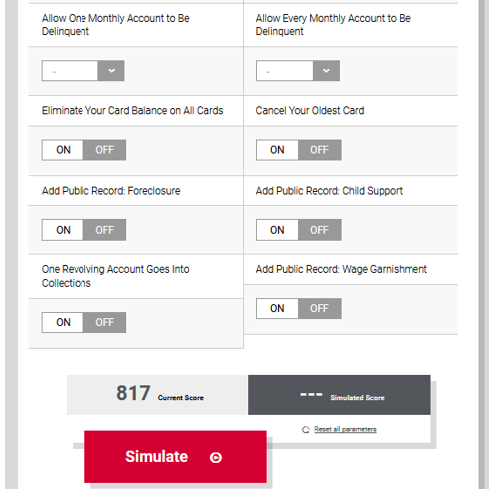
Borrowers’ Worries & Stress:
“Worried My Credit Score May Not Be High Enough”
“The member response has been off-the-charts positive!”
EVP / Chief Credit Officer
UW Credit Union
A few even offer simulators to test impact of different scenarios on your credit scores
Courtesy of UW Credit Union
Notes:
This credit union even enables members to simulate their credit score under a variety of scenarios, e.g., adding another loan, eliminating balances on all cards, etc. As this quote from the Chief Lending Officer suggests the credit union has been very pleased with the response to these tools that help members monitor and manage their credit scores.

Slide 32
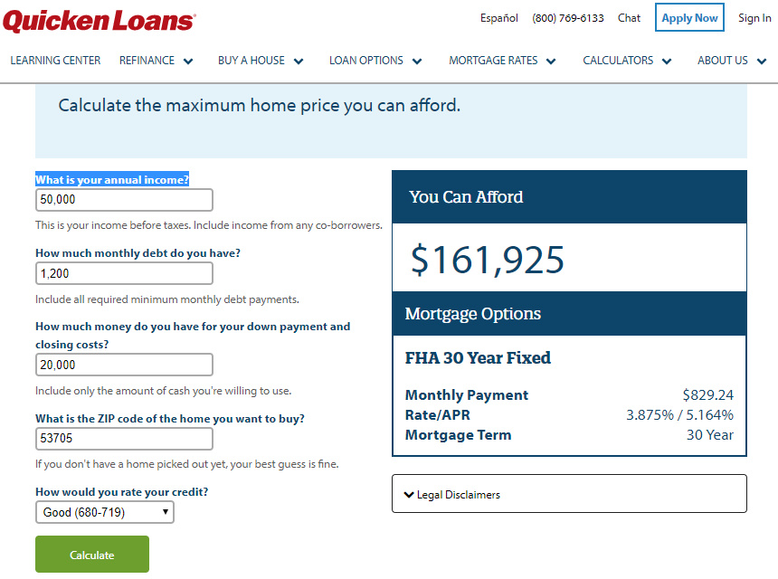
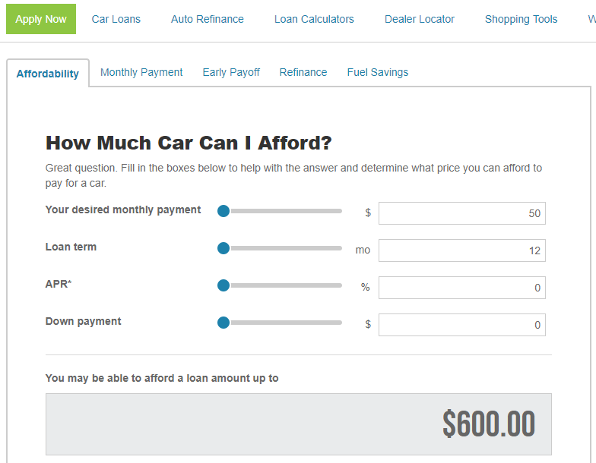
Borrowers’ Worries & Stress:
“Not Certain if I Could Afford Payments”
Some lenders are offering loan affordability calculators
Source: Roadloans.com
Notes:
Some prospective borrowers are concerned that they might not be able to afford their loan payments.
As we see in these two examples, loan affordability calculators are a key way to address this source of stress and worry.
https://www.quickenloans.com/calculator-affordability
https://roadloans.com/finance-calculators/affordability

Slide 33
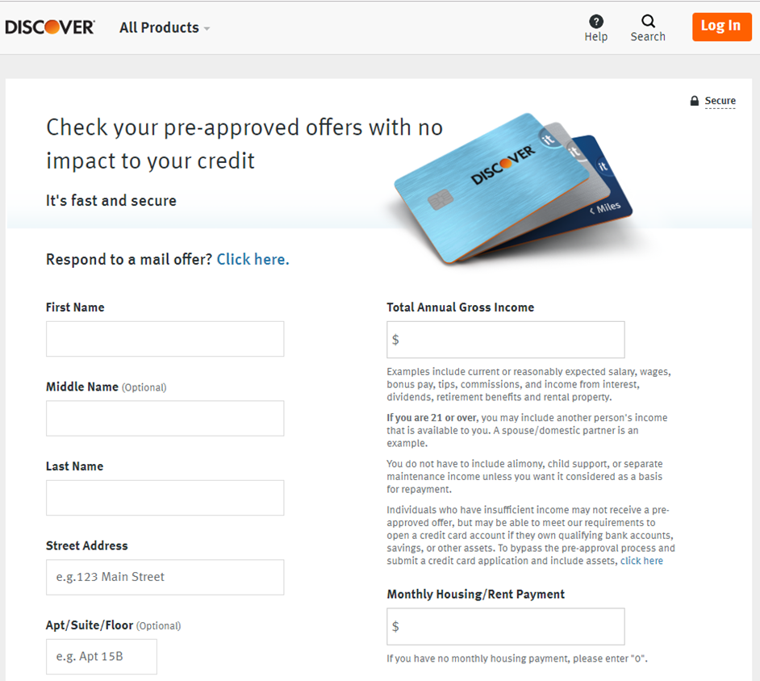
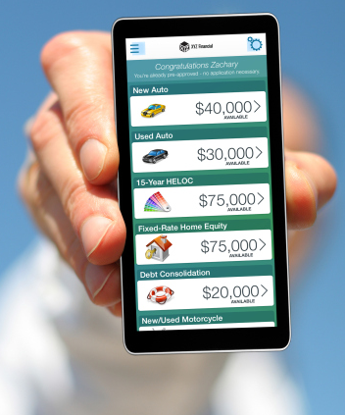
Borrowers’ Worries & Stress:
“Worried About Not Knowing if I Would be Approved”
Source: CUneXus Solutions
Pre-approved and click-to-accept loan offers address this worry
Notes:
According to the research I shared earlier, the top worry of borrowers during the loan application process was not knowing if they would be approved.
Our research shows that some lenders are presenting pre-approved offers to prospective borrowers; thus, completely circumventing the source of this worry.
An innovative twist on pre-approved loan offers are click-to-accept loan offers, where the prospective borrower can see all the loan types / amounts for which they have been pre-approved.

Slide 34

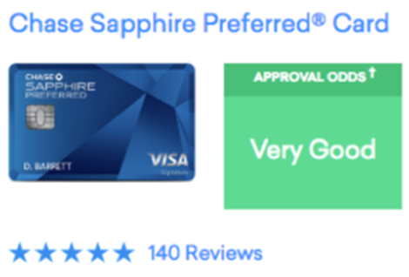
Borrowers’ Worries & Stress:
“Worried About Not Knowing if I Would be Approved”
Credit Karma Approval Odds:
Source: Credit Karma
Credit Karma Even Provides Consumers With “Approval Odds”
Notes:
Another innovative way to address borrowers’ worry about not knowing if they would be approved has been rolled out by Credit Karma.
Some of the biggest U.S. lenders, eager to bring in more borrowers and extend a years long expansion in consumer credit, are handing over the keys to their loan underwriting process to Credit Karma.
This enables the fintech startup to present credit card shoppers with an approval odds rating for specific credit card offers. Approval Odds can help consumers find a card that matches their credit profile, but they don’t guarantee approval. Ultimately, the lender has the final say.

Slide 35
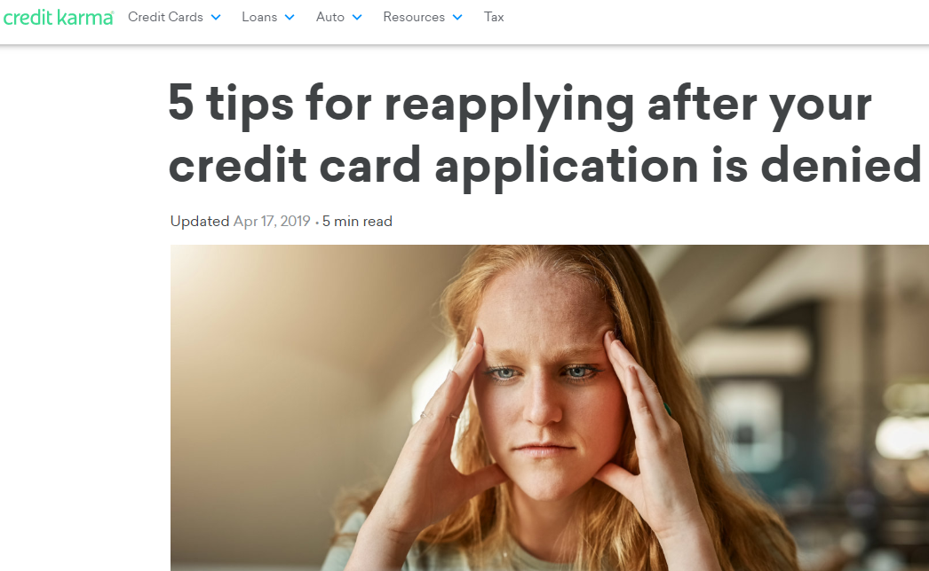
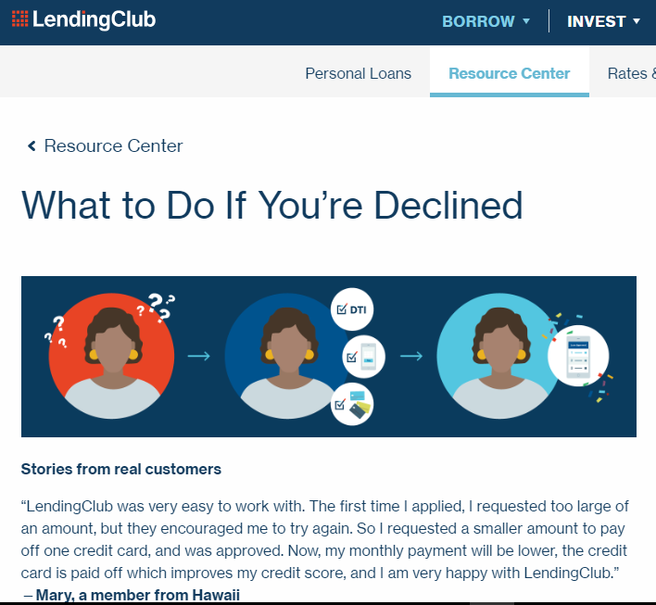
Borrowers’ Worries & Stress:
“Worried About Not Knowing My Alternatives if Denied”
A few lenders do provide advice / tips to consumers who were denied credit
Notes:
Another key worry of borrowers during the application process is not knowing their alternatives if they are denied credit.
As we can see in these two examples, some fintech startups are providing advice and tips to consumers who were denied credit.

Slide 36
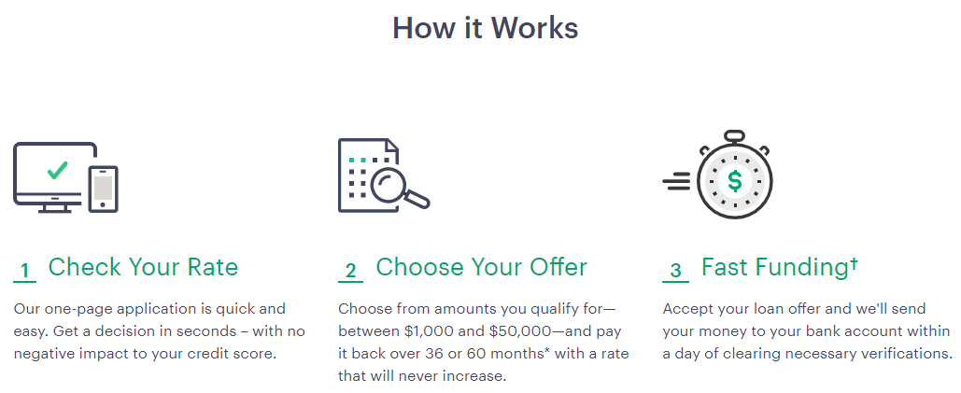
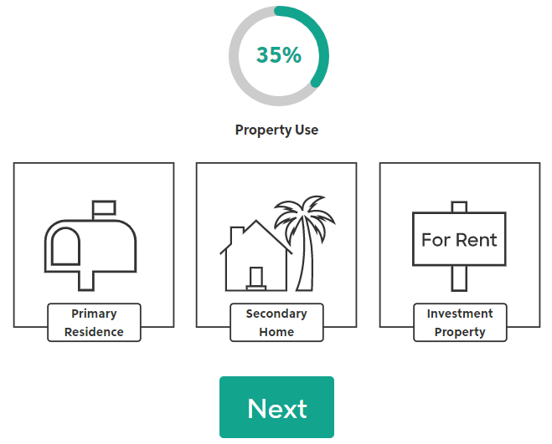
Borrowers’ Worries & Stress:
“Stressed About Paperwork & Time Needed to Complete It”
Progress Indicator
Source: Upgrade
Source: Rocket Mortgage by Quicken Loans
Some lenders manage expectations before the application and provide guideposts during the application process to address this worry
Notes:
The amount of paperwork and the time needed to complete is a key source of stress and worry for borrowers that’s completely unrelated to credit quality concerns.
Some lenders manage expectations before the application. Here we see that Upgrade’s application is only one-page long and the loan decision is delivered to the applicant in seconds with no negative impact to their credit score.
Other lenders provide guideposts during the application process to let the applicant know where they are in the application journey so they can estimate how much time remains until completion. Here we see Rocket Mortgage’s simple progress indicator.

Slide 37
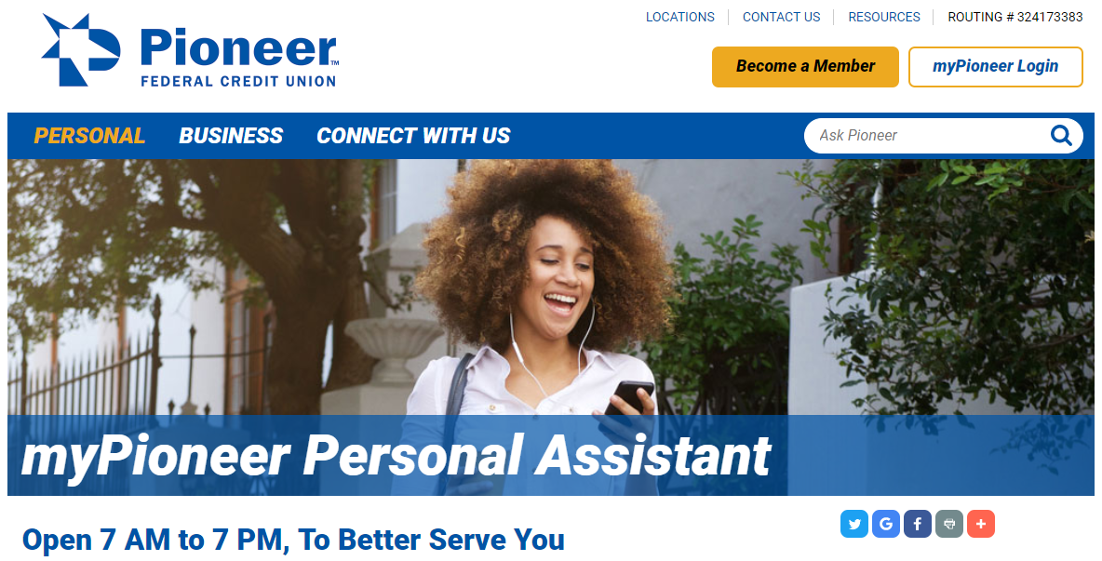
Mobile Video Banking Holds Much Promise
“There is a human element and an emotional impact that video brings that non-video communication doesn’t. …Emotion is the most powerful driver of better customer experience.”
Peter Wannemacher, Forrester Research
Sources: Pioneer Federal Credit Union; “Consumers Love Chatting With Two-Way Video Banking Tech”, thefinancialbrand.com, 4/24/2019
Notes:
While providing members with information and tools can help alleviate borrowers’ worries and stress, human + digital approaches, such as mobile video banking, hold much promise for demonstrating the empathy and reassurance that was traditionally only available through 1:1 contact at a branch or over the phone.
Technology is still very new – Forrester recently surveyed 120 financial institutions around the world and found that only 8% offer this capability.
Early adopters of mobile video banking are very happy with the service they receive. Barclays has recorded Net Promoter Scores from video users 44% higher than for telephony users, and average handling times have fallen 25% as well. At a recent conference, Pioneer FCU also reported receiving a lift in NPS scores from mobile video banking users.

Slide 38
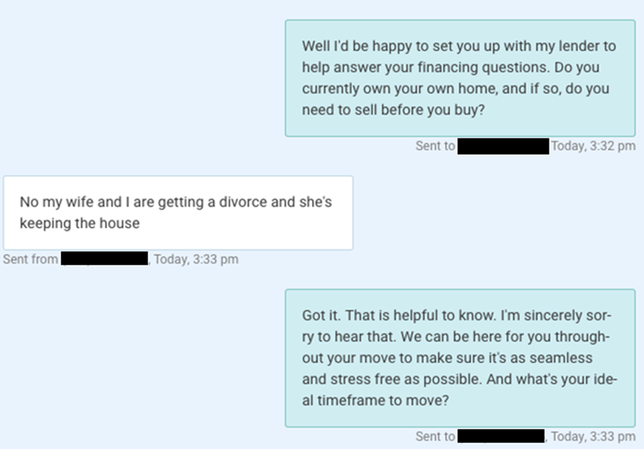
The Future is Closer Than You Think
New artificial intelligence technologies are learning and recognizing human emotions and using that knowledge to make chatbots seem more empathetic
This chatbot can respond with empathy
Source: Structurely; “The power and potential of emotional chatbots”, MarketingTech, 10/19/2018
Notes:
How will financial services companies address the emotional component of customer experience in the future? Technology in this area is improving by leaps and bounds. Most notably, there is a branch of artificial intelligence research called “emotion AI.” Emotion AI is a subset of artificial intelligence that measures, understands, simulates, and reacts to human emotions. It’s also known as affective computing, or artificial emotional intelligence. This slide shows a real-life conversation between a human customer on the left and a chatbot on the right. The chat bot relies on an early version of this technology to provide empathetic responses when it has determined the customer is dealing with difficult life events, such as a death in the family or a divorce.
https://structurely.com/features
https://www.marketingtechnews.net/news/2018/oct/19/power-and-potential-emotional-chatbots/
https://www.opploans.com/why-opploans/

Slide 39

Key Take-Aways
Situation
A majority of your members are worried/ stressed during the lending process
Notes:
To summarize, here are a few take-aways from today’s presentation: [Read]

Slide 40
Key Take-Aways
Situation
A majority of your members are worried / stressed during the lending process
Challenge
CUs generally excel at providing in-person counseling & advice, but you may not see your members in the future
Notes:
[Read]

Slide 41
Key Take-Aways
Situation
A majority of your members are worried / stressed during the lending process
Challenge
CUs generally excel at providing in-person counseling & advice, but you may not see your members in the future
Action
Take steps today to address your members’ stress & worries digitally to drive member loyalty higher
Notes:
[Read]

Slide 42
Key Take-Aways
Situation
A majority of your members are worried / stressed during the lending process
Challenge
CUs generally excel at providing in-person counseling & advice, but you may not see your members in the future
Action
Take steps today to address your members’ stress & worries digitally to drive member loyalty higher
Credit Union Opportunity
Competing on the emotional element of Member Experience (MX) will be THE differentiator in the digital age
Notes:
[Read]

Slide 43
Credit Union Opportunity: Lead on the Emotional Element of MX
High
Level of Delivery
Low
Notes:
As we saw in the earlier Value Curve slide, credit unions have a huge opportunity to differentiate themselves from banks and fintech startups by leading on the emotional element of member experience => Reducing Anxiety. While much of our research focused on stress and worries related to lending, it’s easy to see how addressing members’ stresses and worries related to saving, spending and managing their money could also have a beneficial impact on members’ perceptions of their credit union.
Before I end, I leave you with a few questions to consider and discuss once you return to your respective shops.

